Slide 1
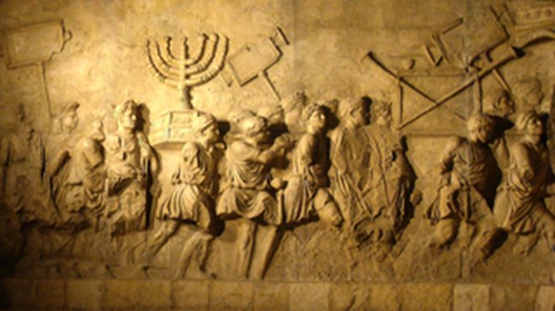
Old Testament Course
Reading The Old Testament: An Introduction
Chapter 19-26
Dr. Andrew Calhoun, Ed.D., M.Div., Th.M., MS

Slide 2
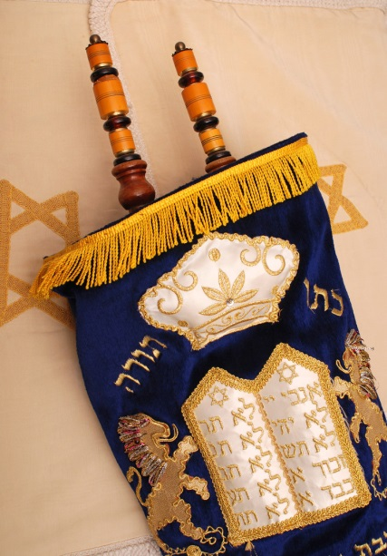
Chapter 19: Prophecy During the Babylonian Exile
Dealing with Loss
  On Living in Exile
  The First Jewish “Diaspora”
B. Ezekiel the Prophet
  The Prophet Called in Exile (Ex. 1-3
  The Nature of the Book of Ezekiel
  Ezekiel’s Theology of Judgment
  The Plan of Restoration
C. The “Priestly” Edition of the Pentateuch
  A New Interpretation of Israel’s Faith
  The Shape of the Priestly Pentateuch
  The Theology of the Priestly Writers

Slide 3
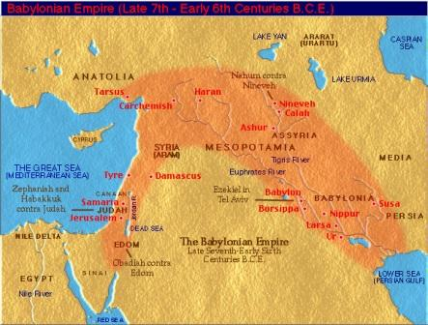
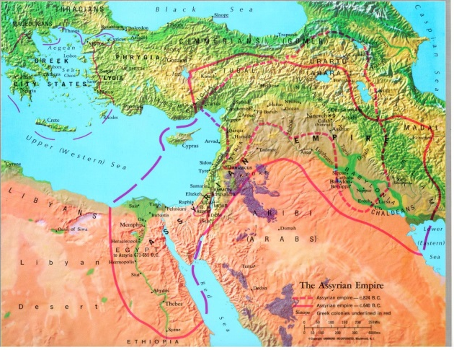
Chapter 19: Prophecy During the Babylonian Exile
Two deportations of 586 & 582.
First one - 2 Kings 24 - King Nebuchadnezzar took away 8 to 10 thousand people to Babylon
Jeremiah 52 - lower number – 3 thousand
Lived with some ease and freedom – settling up towns and villages
The First Jewish “Diaspora”
2 Kings 17: 6 – King Hoshea - northern kingdom
721 B.C. –”The Fall of Samaria” - King Sargon II - 27, 290 deported
Ten Lost Tribes of Israel
http://www.jewishencyclopedia.com/articles/5169-diaspora

Slide 4
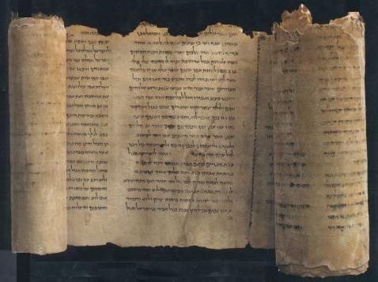
Chapter 19: Prophecy During the Babylonian Exile
B. Ezekiel the Prophet
  The Prophet Called in Exile (Ex. 1-3
  The Nature of the Book of Ezekiel
  Ezekiel’s Theology of Judgment
  The Plan of Restoration
Ezekiel - He ministered to the Jews in Captivity in Babylon. Description of the end of times.
Chapters 1-24: Oracles against Judah and Jerusalem before 586 B.C.
Chapters 25-32: Oracles against foreign nations
Chapters 33-48: Oracles of hope and restoration for Judah
Theology: Uses the Day of the Lord, condemns the sins against justice. Talks about Judgment, bloodshed, violence, evil conduct – bribery, usury, stealing from the poor, (chap. 5, 6, 7 and 18). Violations of religious worship, failing to honor the Sabbath, breaking the law, building idols, eating at the high places. Importance of individual responsibility.

Slide 5
Chapter 19: Prophecy During the Babylonian Exile

Slide 6
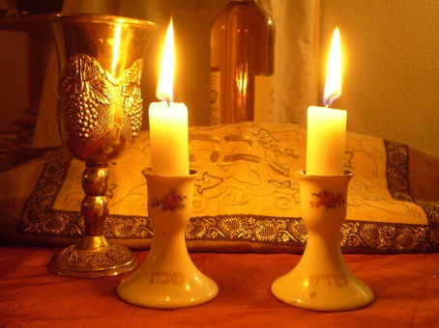
Chapter 19: Prophecy During the Babylonian Exile
C. The “Priestly” Edition of the Pentateuch
  A New Interpretation of Israel’s Faith
  The Shape of the Priestly Pentateuch
  The Theology of the Priestly Writers
1. The first patterns involves the names by which God is known: ‘elohim (Gen 9), El Shaddai (Gen. 17) “the powerful one” and revealing his name as Yahweh (Ex. 3).
2. A second pattern lists the covenants God has made: Adam (Gen. 1: 28-30), Noah (Gen. 1:28), Abraham (Gen 17) and Moses on Mount Sinai (Ex. 6).
3. A third pattern lists the obligations God sets upon the world: Gift of creation – to keep the Sabbath holy (Gen 1); Rainbow as a promise of no world wide destruction again (Gen 17) and Gift of God’s presence always with them, people must keep the law of Mount Sinai (Ex 19 – Numbers 10)
Theology: A new reality requires a refocus, new faith and new vision on the what God wants and how God’s people are to be in relationship with Him. God is beyond the territory. God must be in one’s heart and can be worshiped.

Slide 7
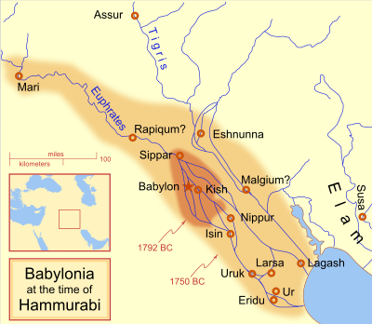
Chapter 20: Sing Us a Song of Zion!
Other Responses to the Exile
  The Devastation of Judah
  The Book of Lamentations
  The Prophet Obadiah
  Psalm 137
  The Exile Nears Its End
  The Rise of Persia as a World Powers
Second Isaiah (Isaiah (40-55)
  Who Was Second Isaiah?
  The Outline of the Book
  The Message of the Prophet
  The Servant Songs

Slide 8
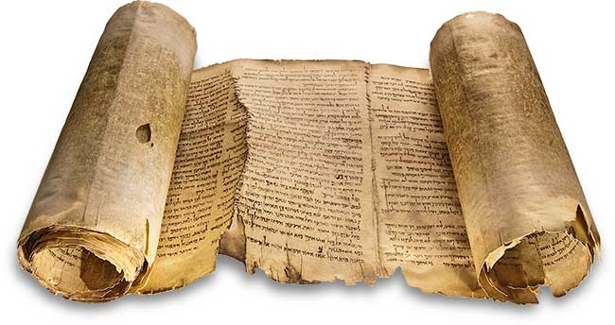
Chapter 20: Sing Us a Song of Zion!
  The Devastation of Judah
  The Book of Lamentations
  The Prophet Obadiah
  Psalm 137
  The Exile Nears Its End
  The Rise of Persia as a World Powers
Lamentations - 5 lament poems. Description of defeat and fall of Jerusalem.
Obadiah - A proclamation against Edom, a neighboring nation of Israel that gloated over Jerusalem's judgments. Prophecy of its utter destruction.
Nebuchadnezzar died in 562 B.C. After 43 years. His sons and successors were not able to match his ability and the empire he had created slowly but surely began to fall apart.

Slide 9
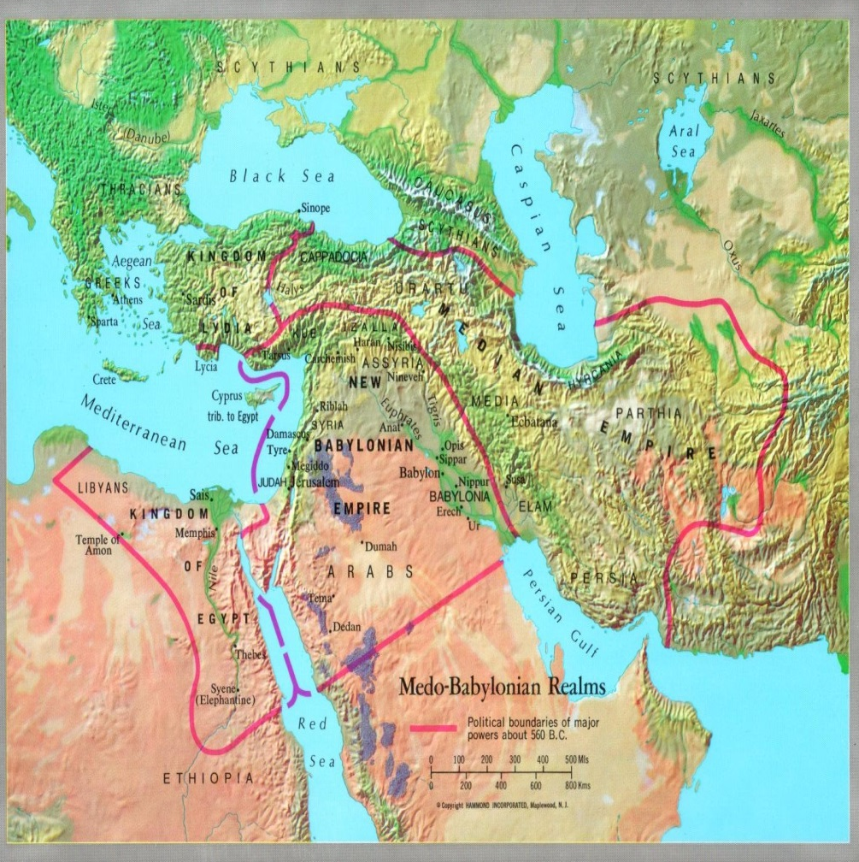
Chapter 20: Sing Us a Song of Zion!
Nebuchadnezzar died in 562 B.C. After 43 years. His sons and successors were not able to match his ability and the empire he had created slowly but surely began to fall apart.
Persia as a World Power

Slide 10
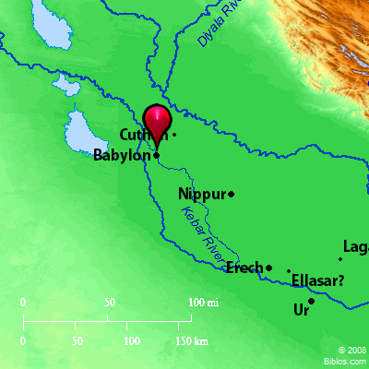
Chapter 20: Sing Us a Song of Zion!
Psalm 137 (KJV)
By the rivers of Babylon, there we sat down, yea, we wept, when we remembered Zion.
² We hanged our harps upon the willows in the midst thereof.
³ For there they that carried us away captive required of us a song; and they that wasted us required of us mirth, saying, Sing us one of the songs of Zion.
⁴ How shall we sing the Lord's song in a strange land?
⁵ If I forget thee, O Jerusalem, let my right hand forget her cunning.
⁶ If I do not remember thee, let my tongue cleave to the roof of my mouth; if I prefer not Jerusalem above my chief joy.
⁷ Remember, O Lord, the children of Edom in the day of Jerusalem; who said, Rase it, rase it, even to the foundation thereof.
⁸ O daughter of Babylon, who art to be destroyed; happy shall he be, that rewardeth thee as thou hast served us.
⁹ Happy shall he be, that taketh and dasheth thy little ones against the stones.

Slide 11
Chapter 20: Sing Us a Song of Zion!
Second Isaiah (Isaiah (40-55)
  Who Was Second Isaiah?
  The Outline of the Book
  The Message of the Prophet
  The Servant Songs
Isaiah 40
God’s word is all-powerful
He will give mercy and forgiveness
God will do new things never done before
There will be a new exodus
Yahweh is the Redeemer of Israel
There will be a new creation
There is a role for all nations in God’s plan
Yahweh will restore Zion
The message changes from judgment and condemnation of Israel to one of trust and confident hope that God is about to end the exile.
God is the Holy One of Israel
God uses foreign rulers and nations as his instruments to punish Israel, but will in turn punish the evil that those nations do in excess
He makes his home in Jerusalem on Mount Zion and from there his salvation goes forth.

Slide 12
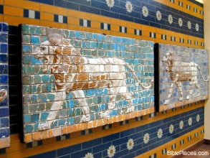
Chapter 21: The Struggle to Restore the Land (540-500 B.C.)
  Persian Political Policy
  Persian Religion: Zoroaster
  Biblical Sources for the Period after the Exile
  The Return Gets Underway
  Opposition and Difficulties
  The Prophet Haggai
  The Prophet Zechariah
  Second Zechariah
  Isaiah 56-66
  Changes in Prophecy in the Exile and After

Slide 13
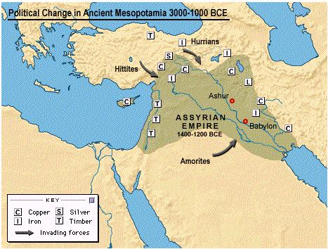
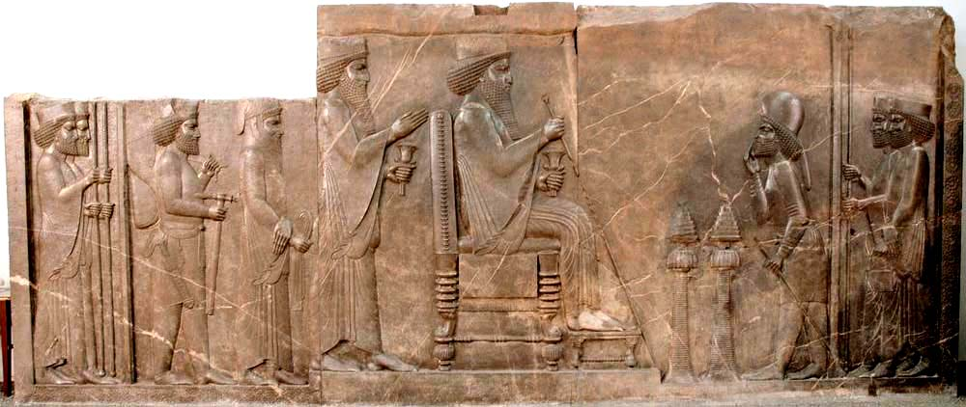
Achaemenid Dynasty
559-530 – Cyrus the Great
529-522 - Cambyses (son)
522 - Smerdis (Bardiya) (brother)
521-486 – Darius I, the Great
485-465 - Xerxes I (son)
464-424 - Artaxerxes I, Longimanus (son)
424 - Xerxes II (son)
424 - Sogdianus (brother)
423-405 - Darius II, Nothus (brother)
404-359 - Artaxerxes II, Mnemon (son)
358-338 - Artaxerxes III (Ochus) (son)
337-336 - Artaxerxes IV ( Arses) (son)
335-330 - Darius III (Codomannus) (great-grandson of Darius II)
Macedonian conquest of the Persian empire 330
Seleucids
305-281 B.C. - Seleucus I Nicator
281-261 - Antiochus I Soter
261-246 - Antiochus II Theos
246-225 - Seleucus II Callinicus

Slide 14
Chapter 21: The Struggle to Restore the Land (540-500 B.C.)
Haggai - The people failed to put God first, by building their houses before they finished God's temple. Therefore, they had no prosperity.
Zechariah - Zechariah encourages the Jews to complete the temple. Many messianic prophecies.
  Isaiah 56-66
  Changes in Prophecy in the Exile and After
There is a renewal and new energy to provide some spiritual guidance to Israel to get them ready for coming back to the promise land.
New tone - the Yoke is being broken… chains being broken … sharing bread with the poor… clothing the naked

Slide 15
Chapter 22: Life in the Post-Exilic Community
First Chronicles - A recounting of the history of Israel to the time of Solomon.
Second Chronicles - continued recounting of the life of Solomon, building of temple, to the captivity. History of Judah only.
Ezra - Cyrus let most of the Jews return to their land of Israel. Zerubbabel led the people (539 B.C.). Ezra returned later with more Jews (458 B.C.) Built the temple.
Nehemiah - Building the walls of Jerusalem. Nehemiah got permission from the king of Persia to rebuild the walls (444 B.C.). Revival in the land.

Slide 16
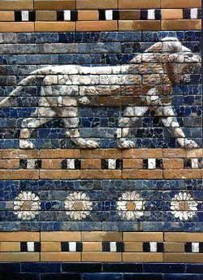
Chapter 22: Life in the Post-Exilic Community
The Work of the Chroniclers
The Books of Chronicles
The Book of Ezra
The Book of Nehemiah
Confusion between Ezra’s and Nehemiah’s Reforms
Ezra and the Beginning of the Old Testament Canon
The Samaritans
The Jewish Colony at Elephantine
The Book of Malachi
The Book of Joel
The Book of Jonah

Slide 17
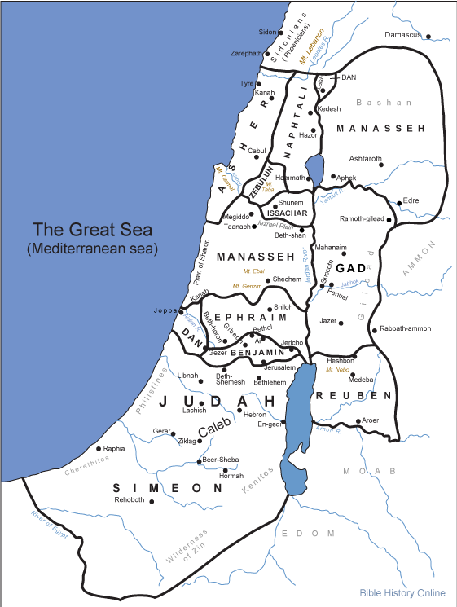
Chapter 22: Life in the Post-Exilic Community
Malachi. - God's people are lax in their duty to God. Growing distant from God. Moral compromise. Proclamation of coming judgment.
Joel - Proclaims a terrifying future using the imagery of locusts. Judgment will come but blessing will follow.
Jonah - Jonah proclaims a coming judgment upon Nineveh's people. But they repented and judgment was spared.

Slide 18
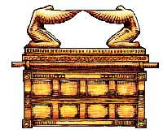
Chapter 23: The Cultivation of Wisdom
What Is a Wisdom Book?
The Origins of Wisdom in Israel
The Way of the Wise
The Book of Proverbs
The Book of Job
The Book of Ecclesiastes
The Songs of Songs (The Canticle of Canticles)
Sirach (Ecclesiasticus)
The Book of Wisdom
The Achievement of Wisdom

Slide 19
Chapter 23: The Cultivation of Wisdom
What Is a Wisdom Book?
The Origins of Wisdom in Israel
The Way of the Wise
Wisdom books are differ in both style and subject matters. However they all have a certain common characteristics with set them apart from other biblical books.
Minimum interest in great acts of divine salvation proclaimed by the Torah and prophets
Little interest in Israel as a nation or in its history
Questing attitude about the problems of life: why there is suffering, inequality and death, and why the wicked prosper
Search for how to master life and understand how humans should behave before God
Great interest in the universal human experiences that affect all people and not just believers in Yahweh
Joy in the contemplation of creation and God as Creator
Two major sources for Israel’s interest in wisdom.
The family
Formal education

Slide 20
Chapter 23: The Cultivation of Wisdom
Proverbs - Practical wisdom in everyday affairs.
Job - a righteous man tested by God. Deals with God's sovereignty.
Ecclesiastes - All is vanity. The wisdom of man is futility.
Song of Solomon - A song between Solomon and his Shulammite bride, displaying the love between a man and a woman.
THE BOOK OF WISDOM
The Book of Wisdom was written about fifty years before the coming of Christ. Its author, whose name is not known to us, was probably a member of the Jewish community at Alexandria, in Egypt. He wrote in Greek, in a style patterned on that of Hebrew verse. At times he speaks in the person of Solomon, placing his teachings on the lips of the wise king of Hebrew tradition in order to emphasize their value. His profound knowledge of the earlier Old Testament writings is reflected in almost every line of the book, and marks him, like Ben Sira, as an outstanding representative of religious devotion and learning among the sages of postexilic Judaism.
http://www.usccb.org/bible/books-of-the-bible/#Wisdom

Slide 21
Chapter 23: The Cultivation of Wisdom
THE SONG OF SONGS
The Song of Songs (or Canticle of Canticles) is an exquisite collection of love lyrics, arranged to tell a dramatic tale of mutual desire and courtship. It presents an inspired portrayal of ideal human love, a resounding affirmation of the goodness of human sexuality that is applicable to the sacredness and the depth of married union.
THE WISDOM OF BEN SIRA (ECCLESIASTICUS)
The Wisdom of Ben Sira derives its title from the author, “Yeshua [Jesus], son of Eleazar, son of Sira” (50:27). This seems to be the earliest title of the book. The designation “Liber Ecclesiasticus,” meaning “Church Book,” appended to some Greek and Latin manuscripts, is perhaps due to the extensive use the church made of this book in presenting moral teaching to catechumens and to the faithful. The title “Sirach” comes from the Greek form of the author’s name.

Slide 22
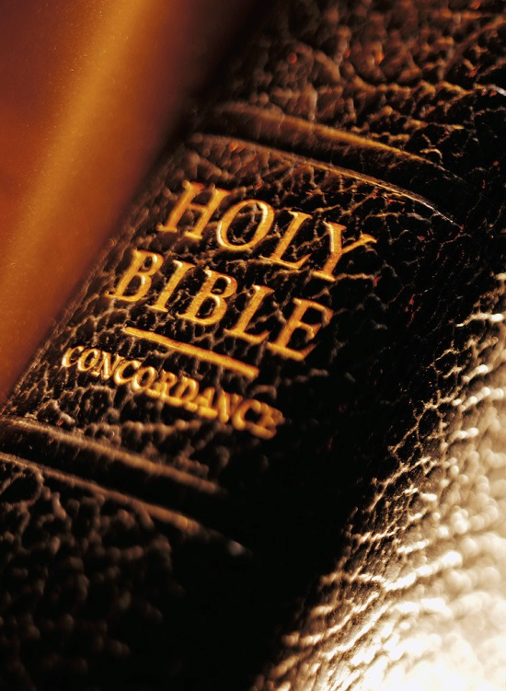
Chapter 24: Faith Confronting New Challenges
Judaism in the World of the Greeks
  Alexander the Great
  Hellenistic Culture
  The Book of Esther
  The Book of Judith
  The Book of Ruth
  The Book of Tobit
  The Book of Baruch and Letter of Jeremiah
  The Jewish Struggle for Freedom (175-160 B.C.)
  The First Book of Maccabees
  The Second Book of Maccabees
B. The Book of Daniel and Apocalyptic Though
  The Book of Daniel
  The Special Purpose of Daniel
  The Lasting Significance of Daniel
  More on Apocalyptic
  The Value of Apocalyptic

Slide 23

Chapter 24: Faith Confronting New Challenges
  Alexander the Great and Hellenistic Culture – A conquer and Greeks take over the ancient world and spreading their culture, philosophy. Great soliders, strong educational system.
The Book of Judith - The Book of Judith relates the story of God’s deliverance of the Jewish people. This was accomplished “by the hand of a female”—a constant motif (cf. 8:33; 9:9, 10; 12:4; 13:4, 14, 15; 15:10; 16:5) meant to recall the “hand” of God in the Exodus narrative (cf. Ex 15:6). The work may have been written around 100 B.C., but its historical range is extraordinary.
Esther - Took place during chapters 6 and 7 of Ezra. Mordecai. Plot to kill the Jewish people.
Ruth - Kinsman redeemer in Boaz, redeeming Ruth, a Moabites. Speaks of righteousness, love, and faithfulness to the Lord.

Slide 24
Chapter 24: Faith Confronting New Challenges
The Book of Tobit, named after its principal character, combines Jewish piety and morality with folklore in a fascinating story that has enjoyed wide popularity in both Jewish and Christian circles. Prayers, psalms, and words of wisdom, as well as the skillfully constructed story itself, provide valuable insights into the faith and the religious milieu of its unknown author. The book was probably written early in the second century B.C.; it is not known where.
The Book of Baruch, The opening verses ascribe the book to the well-known assistant to Jeremiah (Jer 32:12; 36:4, 32; 45:1). It is a collection of four very different compositions, ending with a work entitled “The Letter of Jeremiah,” which circulated separately in major manuscripts of the Greek tradition. The original language may have been Hebrew, but only the Greek and other versions have been preserved. The fictional setting is Babylon, where Baruch reads his scroll to King Jechoniah (Jehoiachin) and the exiles; they react by sending gifts and the scroll to Jerusalem (1:1–14), presumably by the hand of Baruch (1:7).

Slide 25
Chapter 24: Faith Confronting New Challenges
THE FIRST AND SECOND BOOKS OF THE MACCABEES
The name Maccabee, probably meaning “hammer,” is actually applied in the Books of Maccabees to only one man, Judas, third son of the priest Mattathias and first leader of the revolt against the Seleucid kings who persecuted the Jews (1 Mc 2:4, 66; 2 Mc 8:5, 16; 10:1, 16). Traditionally the name has come to be extended to the brothers of Judas, his supporters, and even to other Jewish heroes of the period, such as the seven brothers (2 Mc 7).

Slide 26
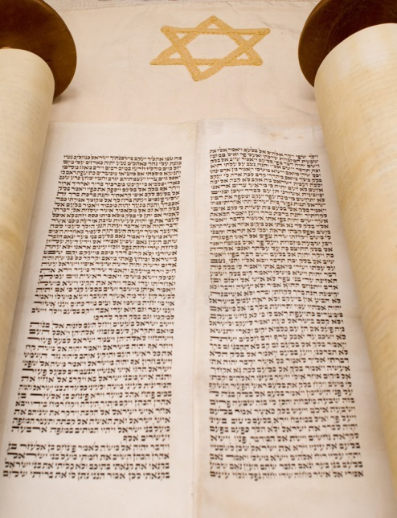
Chapter 24: Faith Confronting New Challenges
B. The Book of Daniel and Apocalyptic Though
  The Book of Daniel
  The Special Purpose of Daniel
  The Lasting Significance of Daniel
  More on Apocalyptic
  The Value of Apocalyptic
Daniel - Many visions of the future for the Gentiles and the Jews.
Part I – Chapters 1-6 - Six romantic stories “court tales”
Part II – Chapters 7-12 – four visions
Part III – Chapters 13-14 - three stories about the hero Daniel
The clear purpose of these visions is to predict in a veiled fashion the end of the kingdom of Antiochus Epiphanes and his Persecution.

Slide 27
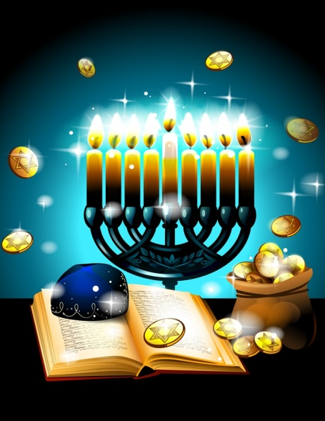
Chapter 25: The Closing of the Old Testament
Judaism at the Dawn of the Christian Era
The End of Jewish Independence and the Rule of Rome
Herod the Great (40 to 4 B.C.)
The Religious Movements of the First Century B.C.
  Pharisees
  Sadducees
  Essenes
The Dead Sea Scrolls
Other Jewish Literature Outside the Bible
The Talmud
Hope for a Messiah
Creating a Canon of Scripture
The Value of the Old Testament for Christians
Themes of Continuity between the New and Old Testaments
Respecting the Old Testament Message

Slide 28
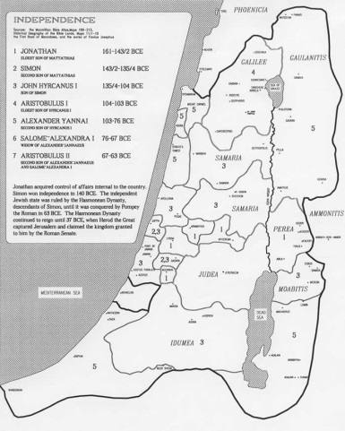
Hasmonean Dynasty in Israel (166- 36 B.C.
http://www.cmj-israel.org/CMJMinistries/ShoreshTours/ssm_mat5htm/tabid/146/Default.aspx

Slide 29

Chapter 25: The Closing of the Old Testament
Herod the Great (40 to 4 B.C.)
The Religious Movements of the First Century B.C.
  Pharisees b) Sadducees c) Essenes
Rome takes control of Palestine and begin to set up a system of local rulers and away from the Hasmonean family.
A lot of inner political fighting among them due to the fact that the high priests being named were not descendants from Aaron or the levities which the law required.
New movements emerge:
The Writings of Josephus, Antiquities and the Jewish War
Philo of Alexandria – Jewish philosopher in Egypt about the time of Christ
Talmud – Jewish pharisaical writings of the first to fourth centuries A.D.
Hints and mentions found among the documents discovered at Qumran.
References made in the New Testament, especially the Gospels.

Slide 30
Chapter 25: The Closing of the Old Testament
The Pharisees: they emerge during the revolt of the Maccabees. They called themselves the hasidim, “the pious ones” or “devout.”
They were not priests, but lay teachers and experts in the law;
They demanded strict obedience to all the laws in the Pentateuch: 613 by their count.
They accepted not only the written Torah, but also an “Oral law” built on the traditions and teachings of the great scribes and religious teachers since the days of Ezra
They believed in doctrines not in the Pentateuch: resurrection of the dead, reward and punishment in the life to come, angels
They put strong stress on human freedom under God’s care and the ability to do good works of the law
They also hoped for a coming “messiah” who would restore the freedom and glory of Israel.
*Key: Belief in the “Oral Torah” or fence around the law.

Slide 31
Chapter 25: The Closing of the Old Testament
The Sadducees: they were the liberals in Jewish life. They made room for lay people in the highest levels of religious life and were open to changing how the law should be interpreted, and yet strongly opposed any pagan influences.
They represented almost the entirely the priestly personnel and the wealthy families of Judah.
The name comes from the high priest under King David, Zadok, and stresses their legitimate claims to the priestly offices.
They represented the most influential and powerful leadership
They played a major role in all national decision.
They claimed to preserve the old traditions against innovations of the Pharisees
They embarrassed the Greek Ways of dressing and speaking
They were primarily concerned for the tradition that protected the central role of the temple and its sacrifices and cult.
They were suspicions of the Pharisees and their “lay theology.”
They formed an important groups in the Sanhedrin, the council of Jewish leaders that decided religious matters during the Roman period .

Slide 32
Chapter 25: The Closing of the Old Testament
The Essenes: They name means “pious ones.” They lived alone the Dead Sea.
Lived celibate lives and is believed to be connected to the Qumran area which is best known with the discovery of the Dean Sea Scrolls.
Community life with shared possessions.
Loyalty to the teaching of the “Righteous Teacher,” their founder who opposed the attempts of the “Wicked Priest” to follow as high priest those who wer not qualified.
A frequent use of water in rites for cleansing and admission to the group
Living of celibacy because the final times are present
The coming of two messiahs: The “Messiahs of Aaron and Israel,” one a political ruler and the other a priest.
It is believed that they were a part of the hasidim movement and they broke away with the Sadducees and Pharisees over issues of legitimate to worship, temple, who could become the high priest.

Slide 33
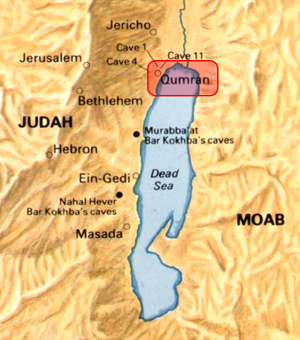
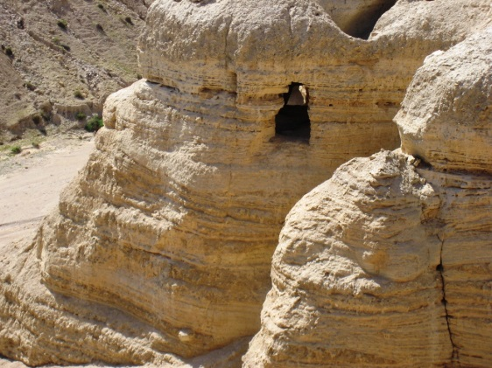
Chapter 25: The Closing of the Old Testament
The Dead Sea Scrolls
Dead Sea Scrolls include:
Biblical Texts
Biblical Commentaries
Apocrypha and Pseudepigrapha
Essene Community Documents
  The Community Rule
  The War Scroll
  The Thanksgiving Scroll
  The Zadokite Document
  The Genesis
  The Temple Scroll
  The Copper Scroll

Slide 34
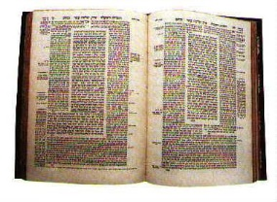
Chapter 25: The Closing of the Old Testament
Other Jewish Literature Outside the Bible
Apocrypha
Greek for “hidden” or “secret” works.
The books of Jubilees
The Testament of the Twelve Patriarchs
Psalms of Solomon
Letter of Aristeas
3rd Maccabee
4th Maccabees
Philo of Alexandria
Josephus
Talmud
A collection of post-biblical laws and teachings that originated with the rabbis who worked in either Babylon or Palestine in the first four Christian centuries.
Agriculture
Festivals
Women
Damages & Injuries
Holy Things
Purity
Pseudepigrapha – “false Writings”

Slide 35
Chapter 25: The Closing of the Old Testament
Hope for a Messiah
Creating a Canon of Scripture
The Value of the Old Testament for Christians
Themes of Continuity between the New and Old Testaments
Value
Promise
Fulfillment
Messiah – one “anointed”
Promise of God
Emmanuel – God with us
Throughout the OT
Messianic hope
The Messiah-king
Kingship
Redeemer
Bring Salvation
Themes
Monotheism – God of compassion
Covenant – The New Testament
The Word of God – Jesus - the Living word of God
The Spirit of God –power of God acting
The Kingdom of God
Universal Salvation – God love for humanity
The Suffering Servant – Jesus dying for human salvation
Canon of Scripture
Rabbis
Jewish Leaders

Slide 36
Chapter 26: Themes of Old Testament Theology
Discovering the Central Focus of the Bible
The Only God
God Active in History
Personal response and Prayer
Covenant and Tradition
The Prophets and Justice
Hope and the Future
The Mystery of God’s Ways

Slide 37
Chapter 26: Themes of Old Testament Theology
There are many themes in the Old Testament
OT is a rich book
Written over many centuries by various authors and containing such a wide variety of Israel’s religious traditions and it is difficult to find any threads of how to unify the book.
Various viewpoints, it is historical, and tells the factual story of God’s interventions into human history on behalf of the Israelites.
Not ordinary history, but is a special “salvation history” with God revealing Himself in events
It is a celebration of Israel in its relationship with God
It is a “confession” or “proclamation”
It reflects choice, covenant, holiness and promise
It is the person of God; Who is God? What does God Do? And Why does God do it?
It tells of the universal greatness and love of God for His creation

Slide 38

Chapter 26: Themes of Old Testament Theology
First and most important theological theme: God is one.
God is holy
God is shepherd
God is Father,
God is creator
Transcendence of God: Nearby and not far away.
Second theological theme: God is an actor in history. It reveals that history is not neutral, but a stage for the discovery of the self-revealing God. God can act upon human events to change the outcomes to fit into the “salvation history.”
Third theological theme: Human Response to What God Does. Demands from us a personal response of friendship, loyalty, obedience an communication. To recognize God’s “glory” in the world. Constant praise of the living and present God in the its midst.

Slide 39
Chapter 26: Themes of Old Testament Theology
Fourth theme: Concrete application of the human response through prayer and praise of God. All the bible tells of the glory of God.
Fifth theological theme: Community and Covenant. OT came into existence as the remembering by an on-going community who received what had been the testimony of others. Covenant relationship. Inner bond and love of neighbor.
Sixth theological theme: Israel is a people of tradition and institutions. It’s the Torah, “teaching” or their “way of life.”
Seventh theological theme: Tension between God’s will and our often sinful and selfish response. Human nature as always good and God as always forgiving of any and every fault. Awareness of Justice, be like God, and Ethics,

Slide 40
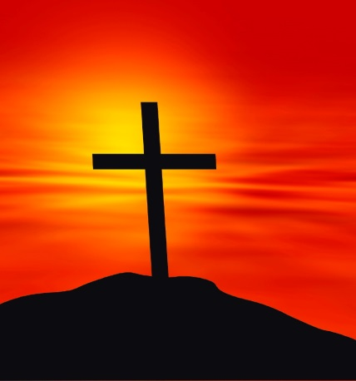
Chapter 26: Themes of Old Testament Theology
Eight & Nine theological themes: Hope and Optimism about the future, goodness of the world. Prophets are watchdogs, critic and challengers of Israel’s evil ways. To bring balanced and also bring comfort and hope in times of trouble and loss.
“Eschatology”: the dynamic expectation that God will act in the future. A confidence that God has all of them and human history under a plan and that there will be moments of profound change when He intervenes.
The hope of the messiah and being faithful. God does not do what you hope for; he acts in new and surprising ways. We cannot expect it, but we must know God well enough to accept it.
Tenth theological theme: Bible as Wisdom. God made all humans rational and free, with the divine power of searching and choosing and behaving ethically.

