Slide 1
Old Testament Course
Reading The Old Testament: An Introduction
Lawrence Boadt
Chapter 1-5
Dr. Andrew Calhoun, Ed.D., M.Div., Th.M., MS

Slide 2
Chapter 1 Introducing The Old Testament

Slide 3
Chapter 1 Introducing The Old Testament
Overview of Chapter
What is the Bible?
Divine Revelation
The Nature of the Old Testament
The Books of the Old Testament
The Canon and Deuterocanonical Books
The Term “Old Testament”
Brief Survey of the Total Picture of the Old Testament
How to Use This Textbook

Slide 4
Chapter 1 Introducing The Old Testament
What is the Bible?
The English word “Bible” comes from the Greek ta biblia which means “The Books”
It is a collection of many individual works and not the product of single person.
The first project that was printed in 1453 on the first printing press by Gutenberg. This first copy was printed in Latin.
Reasons to explain the value of Bible Study…
It is a treasure chest of the wisdom and inspiration
It contains some of the most profound insights into the meaning of human life
It is the single most important sources for our Western culture, especially the expressions and words we use
It has had the most profound influence on modern religious thought
It is the most complete history of the ancient past that we posses

Slide 5
Chapter 1 Introducing The Old Testament
Divine Revelation
All religion is some fashion or another seeks to make known divine communication to humans. This “knowledge” can come through the discovery of ‘god in nature or through actual divine words and decrees. The Old Testament knows both.
Biblical Interpretation
What is the literal sense of a passage is not always as obvious in the speeches and writing of the ancient authors of the East as it is in our own times. For what they wished to express is not to be determined by the rules of grammar and philology alone, nor solely by the context. The interpreter must go back wholly in spirit to those remote centuries of the East and with the aid of history, archaeology, ethnology and other sciences, accurately determine what modes of writing the authors of that period would be likely to use, and in fact did use. Pope Pius Xii 1943

Slide 6
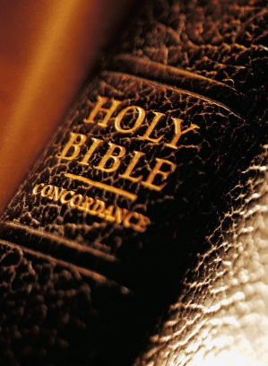
Chapter 1 Introducing The Old Testament
The Nature of the Old Testament
For Christians it is the book of revelation that is contained in both the Old and New Testament.
For Jews it contains only the Old Testament.
The New Testament proclaims the life and message of Jesus Christ as “good news” for all peoples, and sees in Jesus the continuation and fulfillment of the Old Testament hopes of a Savior and Messiah.

Slide 7
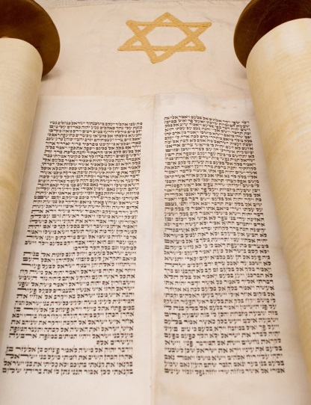
Chapter 1 Introducing The Old Testament
The Books of the Old Testament
46 books – Catholic
39 books – Protestant and Jewish
4 division – Catholic and Protestant
3 division – Jewish (Torah, Nebi’im, Ketubim)
Written Language: Hebrew, Aramaic and Greek (Septuagint)

Slide 8
Chapter 1 Introducing The Old Testament
The Books of the Old Testament
The Old Testament has 39 books total, which consist of...
Pentateuch - 5 books Genesis, Exodus, Leviticus, Numbers, Deuteronomy
Historical Books - 12 books Joshua, Judges, Ruth, First Samuel, Second Samuel, First Kings, Second Kings, First Chronicles, Second Chronicles, Ezra, Nehemiah, Esther.
Poetic books- 5 books Job, Psalms, Proverbs, Ecclesiastes, Song of Solomon
Prophetic books- 17 books Major Prophets - Isaiah, Jeremiah, Lamentations, Ezekiel, Daniel Minor Prophets - Hosea, Joel, Amos, Obadiah, Jonah, Micah, Nahum, Habakkuk, Zephaniah, Haggai, Zechariah, Malachi.
http://carm.org/old-testament-books

Slide 9
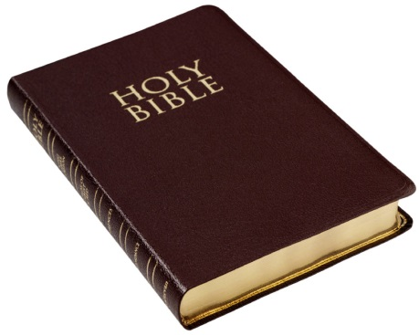
Chapter 1 Introducing The Old Testament
The Canon and Deuterocanonical Books
Cannon includes official writings “measured” by the church and recognized to contain divine revelation. This contains the 39 books.
Deuterocanonical Books includes 7 books as found in the Catholic Bible.
1 & 2 Maccabees
Judith
Tobit
Baruch
Sirach
The Wisdom of Solomon
The Term “Old Testament”
Testament was the Latin word chosen to translate the biblical idea of “covenant.”

Slide 10
Chapter 1 Introducing The Old Testament
Brief Survey of the Total Picture of the Old Testament
Pentateuch - 5 books
Genesis - Creation, the Fall, the Flood, spread of the nations, Abraham, Isaac, Jacob, and Joseph. Enslavement in Egypt.
Exodus - Enslavement, Moses, 10 plagues, Passover, Leave Egypt, Red Sea Crossing, Mt. Sinai and the 10 Commandments
Leviticus - Instructions on sacrificial system and the priesthood. Instructions on moral purity.
Numbers - Still at Mt. Sinai, people make false idol, punishment, 40 years wandering begins.
Deuteronomy - Moses' discourses on God's Acts for Israel the Decalogue, the ceremonial, civil, and social Laws, and covenant ratification.
http://carm.org/old-testament-books

Slide 11
Chapter 1 Introducing The Old Testament
Historical Books - 12 books total
Joshua - First half of Joshua describes the 7-year conquest of the Land of Promise. The last half deals with partitioning the lands to the people.
Judges - Time of Judges. This was a bad time period. The Israelites did not drive out all the inhabitants of Canaan and began to take part in their idolatry. 7 cycles of foreign oppression, repentance, and deliverance. In the end, the people failed to learn their lesson.
Ruth - Kinsman redeemer in Boaz, redeeming Ruth, a Moabitess. Speaks of righteousness, love, and faithfulness to the Lord.

Slide 12
Chapter 1 Introducing The Old Testament
Historical Books - 12 Books
The next 6 books trace the time from Samuel to the Captivity
First Samuel - Samuel carries Israel from judges to King Saul
Second Samuel - David as King, adultery, and murder.
First Kings - Solomon, Israel is powerful. Solomon dies, then division of tribes: 10 to the north and 2 to the south.
Second Kings - The Divided Kingdom. All 19 kings of Israel were bad; therefore, captivity in Assyria (722 B.C.). In Judah, 8 of 20 rulers were good but went into exile too.
First Chronicles - A recounting of the history of Israel to the time of Solomon.
Second Chronicles - continued recounting of the life of Solomon, building of temple, to the captivity. History of Judah only.

Slide 13
Chapter 1 Introducing The Old Testament
The Next 3 books deal with Israel's Restoration
Ezra - Cyrus let most of the Jews return to their land of Israel. Zerubbabel led the people (539 B.C.). Ezra returned later with more Jews (458 B.C.) Built the temple.
Nehemiah - Building the walls of Jerusalem. Nehemiah got permission from the king of Persia to rebuild the walls (444 B.C.). Revival in the land.
Esther - Took place during chapters 6 and 7 of Ezra. Mordecai. Plot to kill the Jewish people.
Poetical - 5 books
Job - a righteous man tested by God. Deals with God's sovereignty.
Psalms - Consists of 5 divisions. Worship in song. Large variety of subjects
Proverbs - Practical wisdom in everyday affairs.
Ecclesiastes - All is vanity. The wisdom of man is futility.
Song of Solomon - A song between Solomon and his Shulammite bride, displaying the love between a man and a woman.

Slide 14
Chapter 1 Introducing The Old Testament
Prophetical - 17 books
Major Prophets - 5 books
Isaiah - Looks at the sin of Judah and proclaims God's judgment. Hezekiah. Coming restoration and blessing.
Jeremiah - Called by God to proclaim the news of judgment to Judah, which came. God establishes a New Covenant.
Lamentations - 5 lament poems. Description of defeat and fall of Jerusalem.
Ezekiel - He ministered to the Jews in Captivity in Babylon. Description of the end of times.
Daniel - Many visions of the future for the Gentiles and the Jews.
Minor Prophets - 12 books
Hosea - Story of Hosea and his unfaithful wife, Gomer. Represents God's love and faithfulness and Israel's spiritual adultery. Israel will be judged and restored.
Joel - Proclaims a terrifying future using the imagery of locusts. Judgment will come but blessing will follow.
Amos - He warned Israel of its coming judgment. Israel rejects God's warning.

Slide 15
Chapter 1 Introducing The Old Testament
Minor Prophets - 12 books (continue)
Obadiah - A proclamation against Edom, a neighboring nation of Israel that gloated over Jerusalem's judgments. Prophecy of its utter destruction.
Jonah - Jonah proclaims a coming judgment upon Nineveh's people. But they repented and judgment was spared.
Micah - Description of the complete moral decay in all levels of Israel. God will judge but will forgive and restore.
Nahum - Nineveh has gone into apostasy (approx. 125 years after Jonah) and will be destroyed.
Habakkuk - Near the end of the kingdom of Judah, Habakkuk asks God why He is not dealing with Judah's sins. God says He will use the Babylonians. Habakkuk asks how God can use a nation that is even worse than Judah.

Slide 16
Chapter 1 Introducing The Old Testament
Minor Prophets - 12 books (continue)
Zephaniah - The theme is developed of the Day of the Lord and His judgment with a coming blessing. Judah will not repent, except for a remnant, which will be restored.
Haggai - The people failed to put God first, by building their houses before they finished God's temple. Therefore, they had no prosperity.
Zechariah - Zechariah encourages the Jews to complete the temple. Many messianic prophecies.
Malachi. - God's people are lax in their duty to God. Growing distant from God. Moral compromise. Proclamation of coming judgment.

Slide 17
Summary Chart - to avoid confusion between so many different editions & versions and sections of "The Bible":
http://catholic-resources.org/Bible/Glossary.htm
Full Name | Abbrev. | Language | Origin | Contents | NT?
Hebrew Bible | HB, or TaNaK | mostly Hebrew originals; some later parts in Aramaic | Hebrew-speaking Ancient Israel (between ca. 1300 and 300 BCE) | 24 books | no
Septuagint | LXX | mostly Greek translations of HB books; some additional books written in Greek | Greek-speaking Jewish Diaspora (Alexandria, Egypt - ca. 250 BCE) | 46 to 53 books | no
Old Testament | OT | originally Hebrew, Aramaic, & Greek; later Latin and all other translations | Christian name for Jewish Scriptures (Cath & Orth use LXX; Prots use HB) | 39 to 53 books | no
New Testament | NT | all originally Greek (some Aramaic sources?); later Latin and all other translations | Greek-speaking early Christians (Eastern Roman Empire; 1st century CE) | 27 books | yes
Vulgate | Vulg. | Latin translations from the various originals | Latin-speaking Western Christianity (St. Jerome; ca. 380-420 CE) | OT & NT | yes

Slide 18
Chapter 2: The People & Lands of the OT

Slide 19
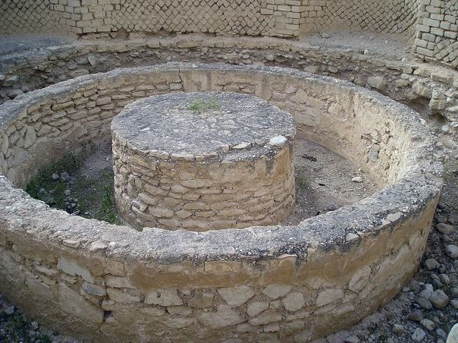
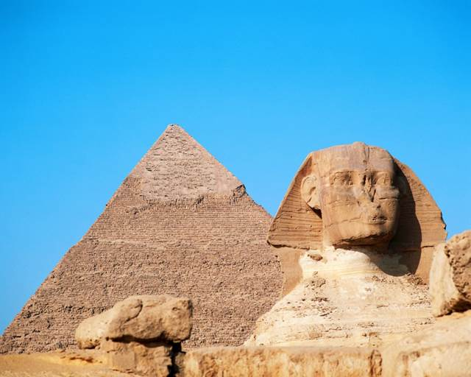
Chapter 2: The People & Lands of the OT
The Importance of “History” and “Geography”
Egypt
A Survey of the Semitic Peoples
Distant Non-Semitic Neighbors

Slide 20
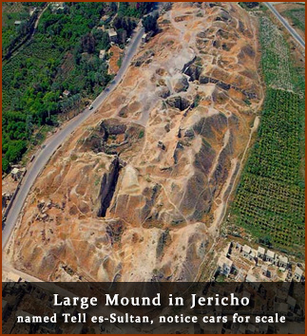
Chapter 2: The People & Lands of the OT
The Importance of “History” and “Geography”

Slide 21
Chapter 2: The People & Lands of the OT
Egypt
The Gift of the Nile – Flows south to north
Upper Nile
Lower Nile
History
Dynasties 1-32 – The Pharaohs
Ramesses II
Tutankhamun (Tut)
“Divine Rights of Kings”
The Land of Pyramids – 138 as of 2008
Giza
Sphinx
Valley of the Kings
Old Kingdom
New Kingdom
http://on.natgeo.com/106aBNe
http://www.pbs.org/wgbh/nova/pyramid/explore/

Slide 22
Chapter 2: The People & Lands of the OT
Egypt
The agricultural system
The invention of a calendar
Monumental architecture and art such as the Pyramids and Sphinx at Giza
Hieroglyphic writing
The invention of papyrus
The status of women

Slide 23
Chapter 2: The People & Lands of the OT

Slide 24
Chapter 2: The People & Lands of the OT
A Survey of the Semitic Peoples
Sumer
The Akkadians
Babylon
Assyria
Syria
The Philistines
The Small States Across the Jordan
Moab – Edom – Ammon - Gilead
Distant Non-Semitic Neighbors
The Hittites
Persia
Greece

Slide 25
Chapter 2: The People & Lands of the OT
A Survey of the Semitic Peoples
Sumer
The Akkadians
Babylon
Assyria
Syria
The Philistines
The Small States Across the Jordan
Moab – Edom – Ammon - Gilead
Distant Non-Semitic Neighbors
The Hittites
Persia
Greece

Slide 26
Chapter 2: The People & Lands of the OT
Babylon
Ishtar Gate
1792 BC
http://www.youtube.com/watch?v=JQIWDPTIYGk

Slide 27
Chapter 2: The People & Lands of the OT
A Survey of the Semitic Peoples
Sumer
The Akkadians
Babylon
Assyria
Syria
The Philistines
The Small States Across the Jordan
Moab – Edom – Ammon - Gilead
Distant Non-Semitic Neighbors
The Hittites
Persia
Greece

Slide 28
Chapter 2: The People & Lands of the OT
Babylon
Mathematics
Agriculture Irrigation
Euphrates & Tigris
Medicine
Architecture
Hanging Gardens of Babylon

Slide 29
Chapter 2: The People & Lands of the OT
A Survey of the Semitic Peoples
Sumer
The Akkadians
Babylon
Assyria
Syria
The Philistines
The Small States Across the Jordan
Moab – Edom – Ammon - Gilead
Distant Non-Semitic Neighbors
The Hittites
Persia
Greece

Slide 30
Chapter 2: The People & Lands of the OT
http://www.preceptaustin.org/map%20of%20abrahams%20journey.gif

Slide 31
Chapter 2: The People & Lands of the OT

Slide 32
Chapter 3: Archaeology & the Old Testament
Pietradi Palermo

Slide 33
Chapter 3: Archaeology & the Old Testament
What is Archaeology?
The Method of Archaeology
Some Major Archaeological Excavation in Palestine
Major Literary Finds in Syria
Major Non-Biblical Literary Finds in Palestine
The Value and Limit of Archaeology

Slide 34
Chapter 3: Archaeology & the Old Testament
What is Archaeology?
Archaeology literally means “the study of beginnings.” It is an organized and systematic science of humanity’s past, it is relatively young, born of the curiosity of the last century.
Archaeology as a science studies the physical remains of the human past.
The Method of Archaeology
“Dig” - the Site
Stratigraphy – it is noting and mapping the strata, or levels, of civilizations and settlement.

Slide 35
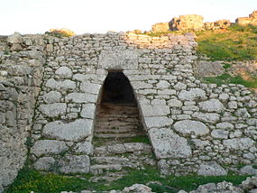
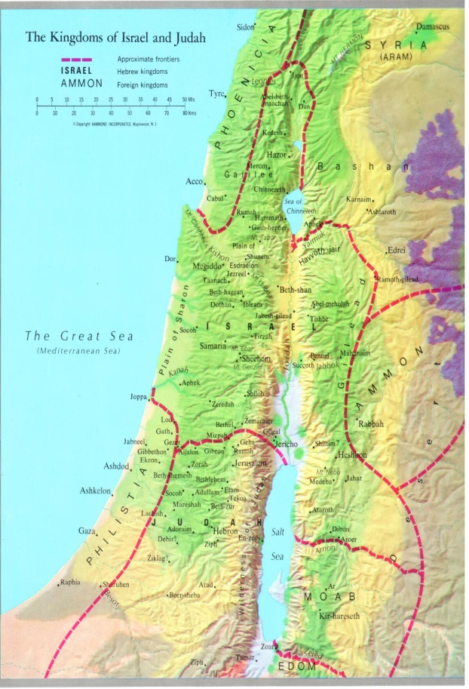
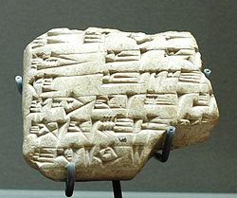
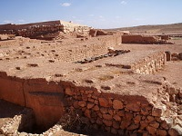
Chapter 3: Archaeology & the Old Testament
Some Major Archaeological Excavation in Palestine
Arad
Gezer
Hazor
Jericho
Jerusalem
Lachish
Megiddo
Samaria
Shechem
Major Literary Finds in Syria
Ugarit
Mari
Ebla

Slide 36
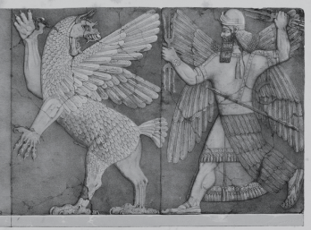
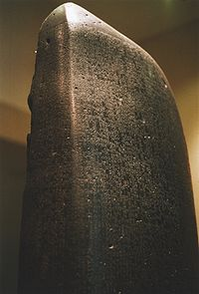
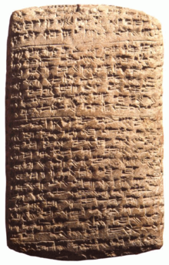
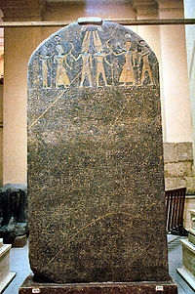
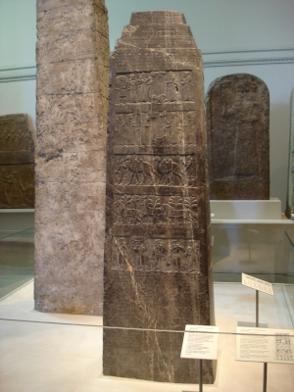
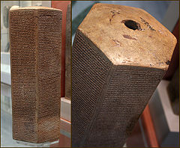

Slide 37
Chapter 3: Archaeology & the Old Testament
Rosetta Stone
Written in three languages:
Greek
Demotic
Ancient Hieroglyphics (picture writing)

Slide 38
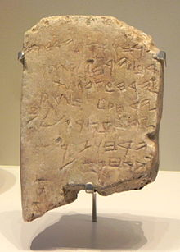
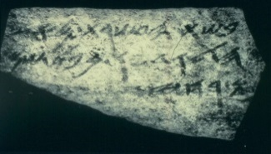
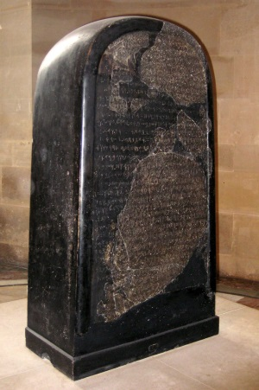
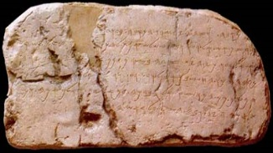
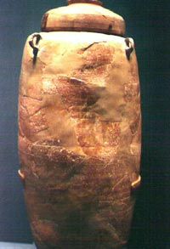
Chapter 3: Archaeology & the Old Testament
Major Non-Biblical Literary Finds in Palestine
The Gezer Calendar
The Moabite Stone
The Samaria Ostraca
The Siloam Inscription
The Lachish Ostraca
Dead Sea Scrolls - Qumran

Slide 39
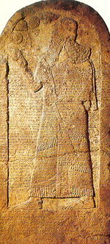
Chapter 3: Archaeology & the Old Testament
Cyrus Cylinder
Karkar
Arch of Titus Menorah

Slide 40
http://www.bible-history.com/black-obelisk/kings-prophets.html

Slide 41
http://www.bible-history.com/black-obelisk/kings-prophets.html

Slide 42
http://www.bible-history.com/black-obelisk/kings-prophets.html

Slide 43
http://www.bible-history.com/black-obelisk/kings-prophets.html

Slide 44
Kings of Israel and Judah
Saul | 1050-1010 BC
David | 1010-970
Solomon | 970-930
Judah (and Benjamin) |  |  |  |  | Israel (Ten Northern Tribes)
King | Reign |  | Character | Prophets | King | Reign |  | Character | Prophets
1. Rehoboam | 931-913 | 17 years | Bad | Shemaiah | 1. Jeroboam I | 931-910 | 22 years | Bad | Abijah
2. Abijah | 913-911 | 3 years | Bad |  | 2. Nadab | 910-909 | 2 years | Bad
3. Asa | 911-870 | 41 years | Good |  | 3. Baasha | 909-886 | 24 years | Bad
 |  |  |  |  | 4. Elah | 886-885 | 2 years | Bad
 |  |  |  |  | 5. Zimri | 885 | 7 days | Bad
 |  |  |  |  | 6. Omri | 885-874* | 12 years | Bad | Elijah Micaiah
4. Jehoshaphat | 870-848* | 25 years | Good |  | 7. Ahab | 874-853 | 22 years | Bad
5. Jehoram | 848-841* | 8 years | Bad |  | 8. Ahaziah | 853-852 | 2 years | Bad
6. Ahaziah | 841 | 1 years | Bad |  | 9. Joram | 852-841 | 12 years | Bad | Elisha
7. Athaliah | 841-835 | 6 years | Bad |  | 10. Jehu | 841-814 | 28 years | Bad
8. Joash | 835-796 | 40 years | Good | Joel | 11. Jehoahaz | 814-798 | 17 years | Bad | Jonah Amos Hosea
9. Amaziah | 796-767 | 29 years | Good |  | 12. Jehoash | 798-782 | 16 years | Bad
10. Uzziah (Azariah) | 767-740* | 52 years | Good | Isaiah Micah | 13. Jeroboam II | 782-753* | 41 years | Bad
11. Jotham | 740-732* | 16 years | Good |  | 14. Zechariah | 753-752 | 6 mo | Bad
12. Ahaz | 732-716 | 16 years | Bad |  | 15. Shallum | 752 | 1 mo | Bad
13. Hezekiah | 716-687 | 29 years | Good |  | 16. Menahem | 752-742 | 10 years | Bad
14. Manasseh | 687-642* | 55 years | Bad/Repented | Nahum Habakkuk Zephaniah | 17. Pekahiah | 742-740 | 2 years | Bad
15. Amon | 642-640 | 2 years | Bad |  | 18. Pekah | 740-732* | 20 years | Bad
16. Josiah | 640-608 | 31 years | Good |  | 19. Hoshea | 732-712 | 9 years | Bad
17. Jehoahaz | 608 | 3 mo | Bad |  | 722 BC Fall of Samaria to Assyria
18. Jehoiakim | 608-597 | 11 years | Bad | Daniel Ezekiel Jeremiah | * Co-regency
19. Jehoiachin | 597 | 3 mos | Bad
20. Zedekiah | 597-586 | 11 years | Bad
Destruction of Jerusalem, 9th Av, 586 BC, Babylonian Captivity

Slide 45
The Last Five Kings of Judah
1. Josiah Reigned 31 years (640-609 BC)
2. Jehoahaz (Shallum) Reigned 3 months (609 BC) Taken prisoner to Egypt by Pharaoh Neco | 3. Jehoiakim (Eliakim) Reigned 11 years (609-598 BC) Died in Jerusalem | 5. Zedekiah Reigned 11 years (597--586 BC) Taken prisoner to Babylon by Nebuchadnezzar
4. Jehoichin (Jeconiah, Coniah) Reigned 3 months (December 9, 598 - March 16, 597 BC) Taken prisoner to Babylon by Nebuchadnezzar (with Ezekiel)
http://www.ldolphin.org/kings.html

