Slide 1
Old Testament Course
Reading The Old Testament: An Introduction
Chapter 12-18
Dr. Andrew Calhoun, Ed.D., M.Div., Th.M., MS

Slide 2
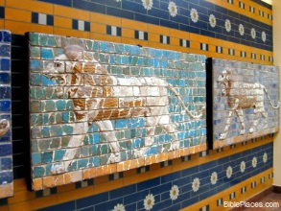
Chapter 12: “A King Like Those of Other Nation’s’: The Books of Samuel and Kings
A. The Books of Samuel and Kings
A Changing World
The Life of Samuel
The Story of Saul
David’s Rise to Power
The Dark Side of David
King David’s Glory
Solomon and Israel’s Age of Glory
Evaluating Solomon’s Reign
B. Kingship in the Ancient World
Kingship Among Israel’s Neighbors
Kingship in Israel

Slide 3
Chapter 12: “A King Like Those of Other Nation’s’: The Books of Samuel and Kings
Historical Books - 12 Books
The next 6 books trace the time from Samuel to the Captivity
First Samuel - Samuel carries Israel from judges to King Saul
Second Samuel - David as King, adultery, and murder.
First Kings - Solomon, Israel is powerful. Solomon dies, then division of tribes: 10 to the north and 2 to the south.
Second Kings - The Divided Kingdom. All 19 kings of Israel were bad; therefore, captivity in Assyria (722 B.C.). In Judah, 8 of 20 rulers were good but went into exile too.

Slide 4
Chapter 12: “A King Like Those of Other Nation’s’: The Books of Samuel and Kings
Samuel - is the major figure in the this period of change. A prophetic and religious leader as well as the most important political voice of the late eleventh century B.C.
The Story of Saul – a valiant warrior and manages to rescue the Israelites of Jabesh-gilead from the Ammonite army, and to win a number of battles against the Philistines, but he never manages to gain that final victory he needs to united Israel.
He is moody, rash temperament
Lack of organizational ability – become his undoing
Arrogance
His reign ends at the great battle on Mount Gilboa – he is killed during the battle.

Slide 5
Chapter 12: “A King Like Those of Other Nation’s’: The Books of Samuel and Kings
David – Young aide to Saul, his armor bearer and musician.
Winning personality
Great skill as a warrior
Kills Philistine hero Goliath – slingshot in a single combat.
Has become popular among the people – 1 Sam. 18:7
Samuel transfers his blessing and anointing from Saul
OUTLINE OF THE BOOKS OF SAMUEL
1 Sam 1-3 The childhood and prophetic call of Samuel
1 Sam 4-6 The story of the Ark of the Covenant in Battle
1 Sam 7-12 Samuel and Israel’s decision to have a king
1 Sam 13-31 The story of Saul’s failure and David’s rise to power
2 Sam 1-8 David’s period of kingship over all Israel
2 Sam 9-20 The “Succession Narrative” of David’s sons
2 Sam 21-24 Appendix of other David traditions

Slide 6
Chapter 12: “A King Like Those of Other Nation’s’: The Books of Samuel and Kings
David – He was both a military and a political genius.
He defeated his Philistine masters and extended the borders of Israel across the small states of Syria and Transjordan.
He became king by mutual agreements with other smaller nations.
He captured the Canaanite city of Jerusalem from the – Jebusites
He made Jerusalem the capital
He brought the ark of the covenant into the city on his palace grounds
Prevented from constructing the magnificent temple by – Prophet Nathan
Dark Side: He murders Uriah to get his beautiful wife Bathsheba (2 Sam 11)
Son Amnon rapes a half-sister Tamar, Tamar’s brother Absalom slays Ammon, Absalom plots against David. Absalom was killed in battle by the General Joab. Another son, Adonijah, tries to take over, saved by Nathan and Zadok the priest and they rushed Solomon to be crowned.

Slide 7
Chapter 12: “A King Like Those of Other Nation’s’: The Books of Samuel and Kings
Solomon – Two outstanding achievements: Wisdom and Built the Temple
He was a major builder
Constructed the wall around the city of Jerusalem
Fortified the major center of Megiddo, Gezer and Hazor as military bases for his chariot divisions
Extensive trade with foreign countries
Commissioned a fleet on the Red Sea
Taxed and regulated the Caravans
Escaped any major wars and enjoyed a long period of peace throughout reign
Married a lot of wives from other nations
Towards the end of his reign there were various revolts. People became fed up with the forced labor. The nation became divided and broke apart.

Slide 8
Chapter 12: “A King Like Those of Other Nation’s’: The Books of Samuel and Kings

Slide 9
Chapter 12: “A King Like Those of Other Nation’s’: The Books of Samuel and Kings

Slide 10
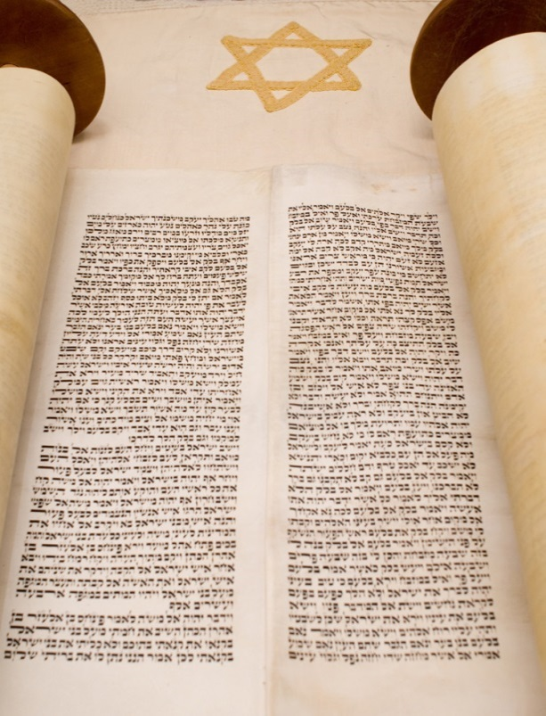
Chapter 13: Daily Life in Ancient Israel
Changing Patterns of Life
City Life
The Human Person in Israelite Thinking
Sickness and Old Age
Death and Afterlife
Daily Work
The Family in Israel
Sexual Attitudes
Marriage Customs
Friends and Enemies
Legal Justice in Early Israel
Royal Justice
Slavery

Slide 11
Chapter 13: Daily Life in Ancient Israel
Big Change : from Nomads to City Dwellers
Development of structures and systems to support a new way of living and a new way of thinking about their faith and its practice
Sickness and taking care of those of Old age
Death and Afterlife – funerals and care of the body
Work – to be fruitful and multiply
Two months of harvesting
Two months of sowing
Two months for later planting
A month for gathering flax
A month for reaping barley
A month for harvesting and gathering
Two months for pruning the vines
A month for gathering summer fruit

Slide 12
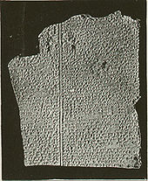
Chapter 13: Daily Life in Ancient Israel
Sexual behavior was carefully regulated. – Mosaic Law
Prostitution – Lev. 20: 10-14 and Deut. 22: 13-30
Homosexuality is outlawed by Lev. 18:22
Marriage Customs
Friends and Enemies
Legal Justice
Royal Justice
Slavery – conditions
Poverty
Prisoners of War

Slide 13
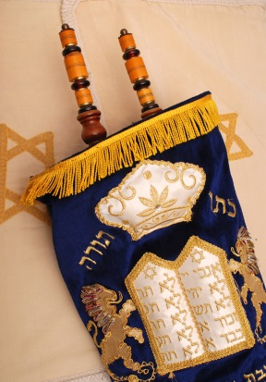
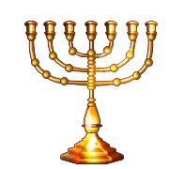
Chapter 14: Israelite Worship and Prayer
The Development of Israelite Worship
From the Beginnings to David
The Temple of Solomon
Temple Worship
Feast Days
The Priests and Levites
The Psalms and Israel’s Prayer
The Piety of Israel
The Nature of the Book of Psalms
The Variety and Richness of the Psalms
The Liturgical Origins of the Psalms
Personal Piety and the Psalms
Sickness and Tragedy in the Psalms

Slide 14
Chapter 14: Israelite Worship and Prayer
http://www.youtube.com/watch?v=6gy-zot9U1Q

Slide 15
Chapter 14: Israelite Worship and Prayer
http://www.youtube.com/watch?v=T4-Ea4rKbrA

Slide 16
Chapter 14: Israelite Worship and Prayer
Temple Worship
Sacrifices is Key
Cult Places
Dan
Shechem
Shiloh
Bethel
Penuel
Jerusalem
Gilgal
El-Roi
Temple Worship
Holocausts Lev 1
Grain Offerings Lev 2
Peace Offerings Lev 3
Sin Offerings Lev 4
Guilt Offerings Lev 5
Role of Priests and Levites
Psalms - Consists of 5 divisions. Worship in song. Large variety of subjects

Slide 17
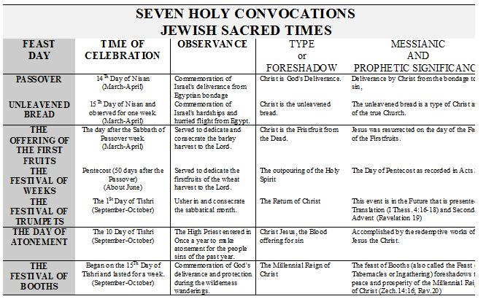
Chapter 14: Israelite Worship and Prayer
http://www.hebrew4christians.com/Holidays/Introduction/introduction.html

Slide 18
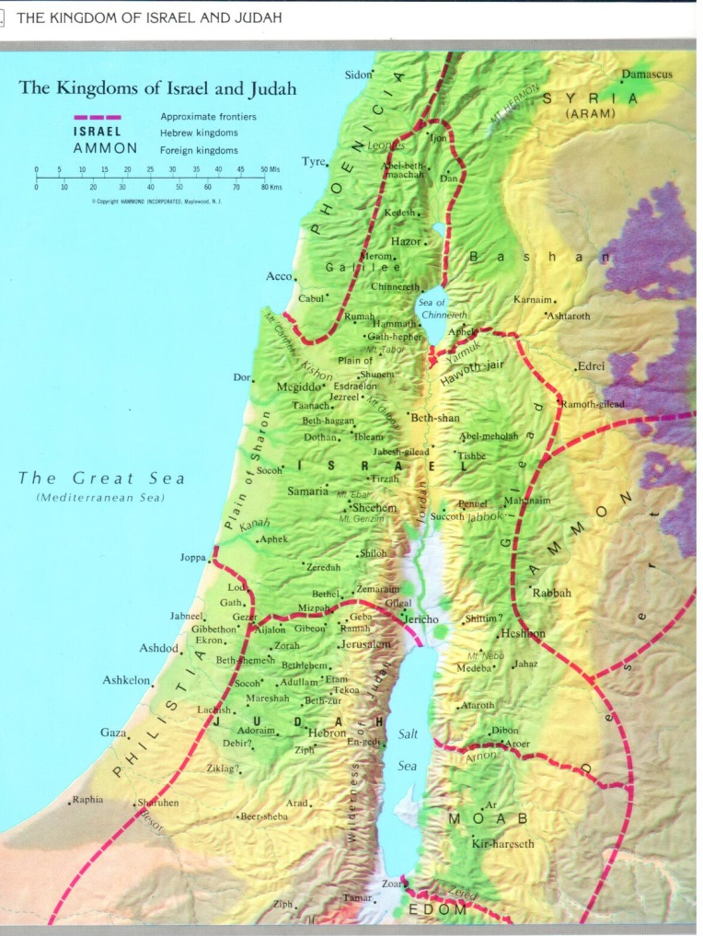
Chapter 15: The Kingdom Split Into Two
Collapse at the Death of Solomon
The Books of Kings
The prophets Elijah and Elisha
The theology of the Books of Kings
The Rise of Prophecy
The Writing Prophets

Slide 19
Chapter 15: The Kingdom Split Into Two
First Kings - Solomon, Israel is powerful. Solomon dies, then division of tribes: 10 to the north and 2 to the south.
Second Kings - The Divided Kingdom. All 19 kings of Israel were bad; therefore, captivity in Assyria (722 B.C.). In Judah, 8 of 20 rulers were good but went into exile too.
The Rise for Prophecy – Development of the School of Prophets
Writing Prophets

Slide 20
http://www.bible-history.com/black-obelisk/kings-prophets.html

Slide 21
http://www.bible-history.com/black-obelisk/kings-prophets.html

Slide 22
Kings of Israel and Judah
Saul | 1050-1010 BC
David | 1010-970
Solomon | 970-930
Judah (and Benjamin) |  |  |  |  | Israel (Ten Northern Tribes)
King | Reign |  | Character | Prophets | King | Reign |  | Character | Prophets
1. Rehoboam | 931-913 | 17 years | Bad | Shemaiah | 1. Jeroboam I | 931-910 | 22 years | Bad | Abijah
2. Abijah | 913-911 | 3 years | Bad |  | 2. Nadab | 910-909 | 2 years | Bad
3. Asa | 911-870 | 41 years | Good |  | 3. Baasha | 909-886 | 24 years | Bad
 |  |  |  |  | 4. Elah | 886-885 | 2 years | Bad
 |  |  |  |  | 5. Zimri | 885 | 7 days | Bad
 |  |  |  |  | 6. Omri | 885-874* | 12 years | Bad | Elijah Micaiah
4. Jehoshaphat | 870-848* | 25 years | Good |  | 7. Ahab | 874-853 | 22 years | Bad
5. Jehoram | 848-841* | 8 years | Bad |  | 8. Ahaziah | 853-852 | 2 years | Bad
6. Ahaziah | 841 | 1 years | Bad |  | 9. Joram | 852-841 | 12 years | Bad | Elisha
7. Athaliah | 841-835 | 6 years | Bad |  | 10. Jehu | 841-814 | 28 years | Bad
8. Joash | 835-796 | 40 years | Good | Joel | 11. Jehoahaz | 814-798 | 17 years | Bad | Jonah Amos Hosea
9. Amaziah | 796-767 | 29 years | Good |  | 12. Jehoash | 798-782 | 16 years | Bad
10. Uzziah (Azariah) | 767-740* | 52 years | Good | Isaiah Micah | 13. Jeroboam II | 782-753* | 41 years | Bad
11. Jotham | 740-732* | 16 years | Good |  | 14. Zechariah | 753-752 | 6 mo | Bad
12. Ahaz | 732-716 | 16 years | Bad |  | 15. Shallum | 752 | 1 mo | Bad
13. Hezekiah | 716-687 | 29 years | Good |  | 16. Menahem | 752-742 | 10 years | Bad
14. Manasseh | 687-642* | 55 years | Bad/Repented | Nahum Habakkuk Zephaniah | 17. Pekahiah | 742-740 | 2 years | Bad
15. Amon | 642-640 | 2 years | Bad |  | 18. Pekah | 740-732* | 20 years | Bad
16. Josiah | 640-608 | 31 years | Good |  | 19. Hoshea | 732-712 | 9 years | Bad
17. Jehoahaz | 608 | 3 mo | Bad |  | 722 BC Fall of Samaria to Assyria
18. Jehoiakim | 608-597 | 11 years | Bad | Daniel Ezekiel Jeremiah | * Co-regency
19. Jehoiachin | 597 | 3 mos | Bad
20. Zedekiah | 597-586 | 11 years | Bad
Destruction of Jerusalem, 9th Av, 586 BC, Babylonian Captivity

Slide 23
The Last Five Kings of Judah
1. Josiah Reigned 31 years (640-609 BC)
2. Jehoahaz (Shallum) Reigned 3 months (609 BC) Taken prisoner to Egypt by Pharaoh Neco | 3. Jehoiakim (Eliakim) Reigned 11 years (609-598 BC) Died in Jerusalem | 5. Zedekiah Reigned 11 years (597--586 BC) Taken prisoner to Babylon by Nebuchadnezzar
4. Jehoichin (Jeconiah, Coniah) Reigned 3 months (December 9, 598 - March 16, 597 BC) Taken prisoner to Babylon by Nebuchadnezzar (with Ezekiel)
http://www.ldolphin.org/kings.html

Slide 24
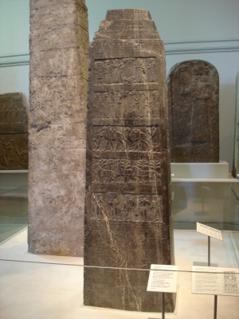
Chapter 16: The Great Prophets of the Eight Century
The Assyrian Rise to Power
Israel’s Age of Prosperity
Collecting and Editing the prophets' Words
Amos: Prophet of God’s Justice
Amos and the Tradition of Prophetic Language
Amos and the Radical New Direction of Prophecy
Hosea and the Knowledge of God
The Prophet of Diving Compassion
Isaiah of Jerusalem
Isaiah and the Historian
The Message of Isaiah
Isaiah and the Royal Traditions of Jerusalem
Micah of Moresheth

Slide 25
Chapter 16: The Great Prophets of the Eight Century

Slide 26
Chapter 16: The Great Prophets of the Eight Century
Most Notable Kings of Assyria 883-628 B.C.
Assurnasirpal II 883-859
Shalmaneser III 858-824
Shamsi-Adad V 823-811
Adad-Nirari III 810-783
Shalmaneser IV 782-773
Assur-Dan III 772-755
Assur-Nirari V 754-745
Tiglath-Pileser III 744-727
Shalmaneser V 726-722
Sargon II 721-705
Sennacherib 704-681
Esarhaddon 680-669
Ashurbanipal 668-628

Slide 27
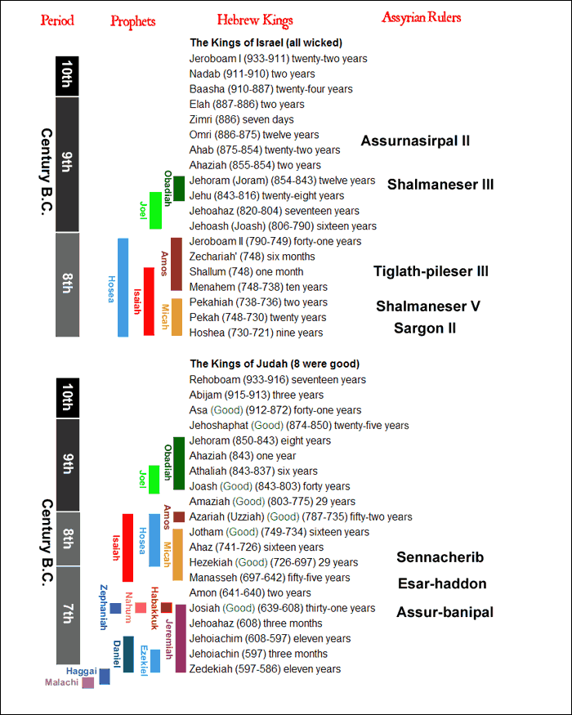

Slide 28
Chapter 16: The Great Prophets of the Eight Century
Amos - He warned Israel of its coming judgment. Israel rejects God's warning.
Called the Prophet of God’s Justice
Hosea - Story of Hosea and his unfaithful wife, Gomer. Represents God's love and faithfulness and Israel's spiritual adultery. Israel will be judged and restored.
Prophet of God Judgment
Isaiah - Looks at the sin of Judah and proclaims God's judgment. Hezekiah.
Coming restoration and blessing.
Prophet of Compassion
Micah - Description of the complete moral decay in all levels of Israel. God will judge but will forgive and restore.
Prophet of Personal Responsibility

Slide 29
Chapter 17: The Last Days of the Kingdom of Judah
The First Half of the Seventh Century
The Book of Zephaniah
King Josiah’s Reform
Josiah’s Political Gains
The Book of Deuteronomy
Deuteronomy and the Covenant
The Place of Worship in the Land
Who Wrote Deuteronomy?
The Results of Josiah’s Reform
The Prophet Nahum
The Prophet Habakkuk

Slide 30
Chapter 17: The Last Days of the Kingdom of Judah
Zephaniah - The theme is developed of the Day of the Lord and His judgment with a coming blessing. Judah will not repent, except for a remnant, which will be restored.
Zephaniah -
Oracles against the sins of Judah (1: 2-2:3 + 3: 1-8)
Oracles against enemy nations (2: 4-15)
Promises of Deliverance (3:9-20)
Written about the time of Josiah’s Crowning
Voice is reaction against the idolatry practiced in the Manasseh’s years
The entire message begins as it begun – praise for God who rules the entire universe

Slide 31
Chapter 17: The Last Days of the Kingdom of Judah
King Josiah’s Reform – 2 Kings 22 – 18th year – 622 BC
Repair the temple which was in poor shape
Begins to bring back standards and balance to worship
Restoring the Worship of Yahweh throughout the land
Put limits on other practices
Abolishes the asherim idols
Ends the cult of the stars,
Ends worship of sun and moon
Destroys cult prostitution
Defiles the Molock cult place
Tears down the high places
Removes all foreign idols
Breaks the pillar idols
Forbids the cult of the dead
Renews the feat of Passover
Extends Political Gains

Slide 32
Chapter 17: The Last Days of the Kingdom of Judah
Deuteronomy - Moses' discourses on God's Acts for Israel the Decalogue, the ceremonial, civil, and social Laws, and covenant ratification.
Outline of the Book of Deuteronomy
General Introduction Chapters 1:1- 4:43
Particular Introduction to Deuteronomic Code Chapters 4: 44-11: 32
Law Code Chapters 12-26
Final Speeches Chapters 29-34
Deuteronomy – Place for Worship in the Land – Northern and Southern
Nahum - Nineveh has gone into apostasy (approx. 125 years after Jonah) and will be destroyed.
Habakkuk - Near the end of the kingdom of Judah, Habakkuk asks God why He is not dealing with Judah's sins. God says He will use the Babylonians. Habakkuk asks how God can use a nation that is even worse than Judah.

Slide 33
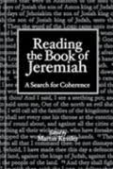
Chapter 18: Jeremiah & the Deuteronomic History
Jeremiah the Prophet
The Background of the Book of Jeremiah
The Political Situation of Jeremiah’s Day
Jeremiah’s Message
The Temple Sermon
Jeremiah’s “Confessions”
The Call of the Prophet
Jeremiah’s Words of Hope
The Deuteronomist’s History
Origins
The Pattern of the Deuteronomic History
Conclusion

Slide 34
Chapter 18: Jeremiah & the Deuteronomic History
Jeremiah - Called by God to proclaim the news of judgment to Judah, which came. God establishes a New Covenant. His minitry extended 45 years
Chapters 1-25: Oracles and accounts involving the evil of Judah under three kings: Josiah (1-6), Jehoiakim (7-20), and Zedekiah (21-24)
Chapters 26-36: Stories about the prophet and oracles from the times of Jehoiakim and Zedekiah.
Chapters 37-45: The Story of Jeremiah’s last days.
Chapters 46-51: Oracles against foreign nations.
Chapters 52: An appendix describing the fall of Jerusalem in 586 (taken from 2 Kings 25 to complete the story of Jeremiah’s words).

Slide 35
Chapter 18: Jeremiah & the Deuteronomic History
Jeremiah –
His ministry extended 45 years.
His preaching was on two themes: Idolatry & Injustice
Temple Sermon – when King Jehoiahkim became king and began to turn back form Josiah’s Reforms. Two accounts: Chapter 7 and 26
He is imprisoned for his views and prophesy – King Jehoiakim and King Zedekiah persecuted him –wanted silence him.
The call of the Prophet: Chapter 1
God speaks to Jeremiah as a young man an tells him that he has been set aside for the task of prophet from before his birth. Similar to Isaiah (1:6 and Ezekiel (1-3).
Words of Hope - Book of Consolation
These are words of healing, visions of fruitful fields, the joy of singing, hope for free travel t Jerusalem for feast and a return the great days of David and Solomon when the nation was one.

Slide 36
Chapter 18: Jeremiah & the Deuteronomic History
Message
Visions
The almond tree 1:11-12
The boiling pot 1:13-19
The loin cloth 13:1-7
The basket of figs 24:1-10
The wine-drinkers 25:15-38
Parables
Jeremiah’s bachelorhood 16: 1-4
The potter at work 18: 1-12
The broker pot 19: 1-20:6
The yoke of iron 27: 1-28:17
The field purchase 32:6-44
The pile of stones 43:8-13
The book in the river 51: 59-64
Most vital and moving of the visions is found in Jeremiah 31: 31-34
The oracle about a “New Covenant. A time when God will renew His Covenant

Slide 37
Chapter 18: Jeremiah & the Deuteronomic History
Deuteronomist’s History – Origins/Pattern of the Deuteronomic History
Written near the end of the sixty yeas spent in Babylon
Deuteronomy and Jeremiah put together the whole history of Israel from the time of Moses down to their own day, about 550 B.C. or even after.
Includes the book of Joshua, Judges, I and 2 Samuel and I and 2 kings. Is often called the Deuteronomists. History because it gets its major inspiration from the theology of Deuteronomy and its deeply prophetic sprit from the life of Jeremiah. It was put together to show that the terrible fate of the people can be understood.
Keys include:
The Covenant between God and the people and why God has punished Israel for Infidelity
The promise of the Land.

Slide 38
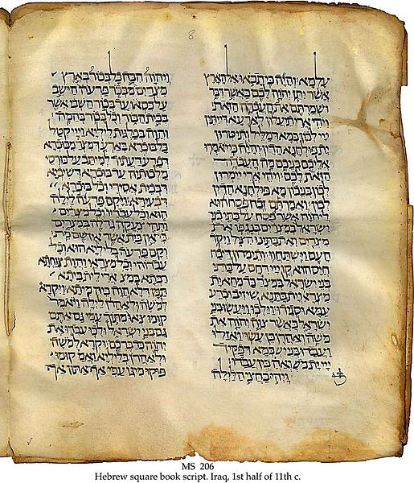
Chapter 18: Jeremiah & the Deuteronomic History
Deuteronomist’s History – Origins/Pattern of the Deuteronomic History
Stage 1: Joshua
Stage 2: The Judges
Stage 3: King David
Stage 4: The Kings
Stage 5: The Fall and Exile
Prophecy
Fulfillment

